Slide 1
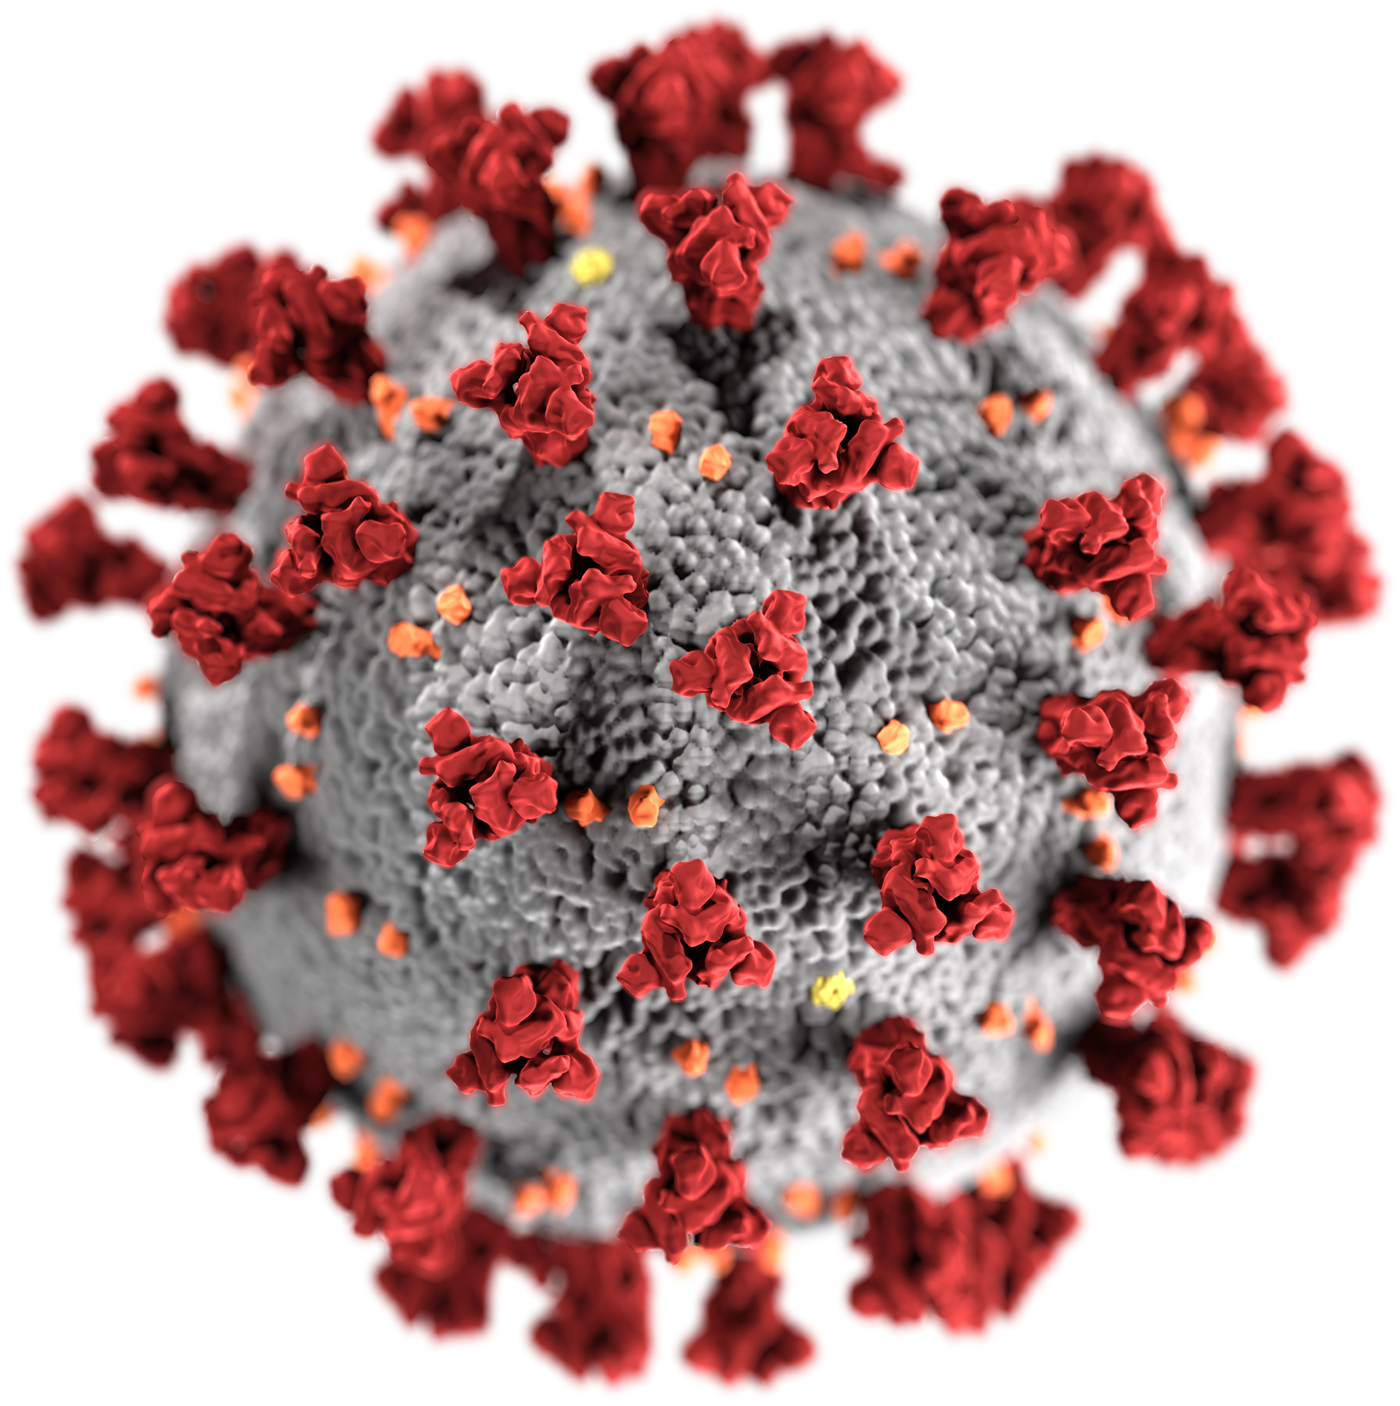
Colorado Covid-19
Predicting County Outbreak via Supervised Machine Learning

Slide 2
Overview
Introduction
Data Sourcing & Preliminary Questions
Exploration Phase
Analysis Phase
A Technology Overview
Summary and Future Analysis

Slide 3
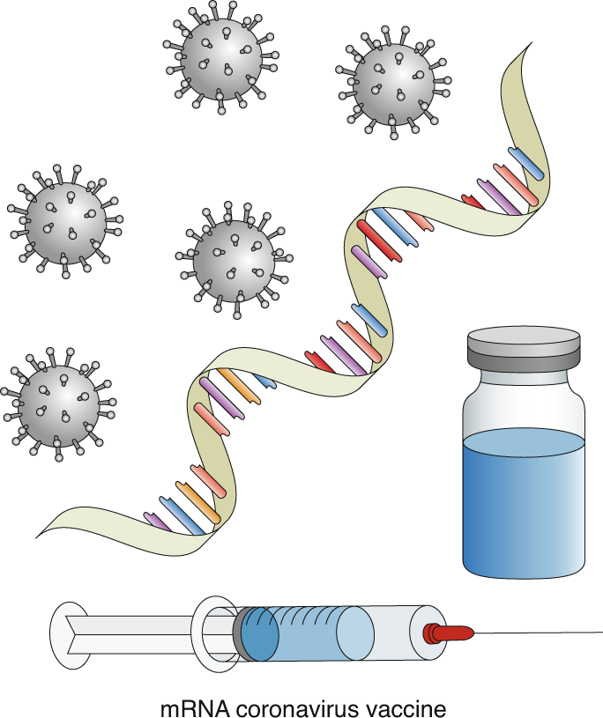
INTRODUCTION
The Covid-19 Vaccines have had a measurable impact on the spread of the coronavirus. While there is evidence that the use of a vaccine can reduce outbreaks, we sought to examine if other factors such as population density and social vulnerabilities could be used to predict the likelihood of a covid infection rate above the average for surrounding areas.
Notes:
SVI Index (https://svi.cdc.gov/Documents/Publications/CDC_ATSDR_SVI_Materials/SVI_Poster_07032014_FINAL.pdf)

Slide 4
Data Sources
CDC - County Vaccination Data
NY Times Covid Data Tracker
Colorado Department of Public Health and Environment
Our World In Data
Notes:
Colorado Department of Public Health Positive Cases Data - https://hub.arcgis.com/datasets/CDPHE::colorado-covid-19-positive-cases-and-rates-of-infection-by-county-of-identification/about
Colorado Health Maps and Index on Community Health Assessment https://www.cohealthmaps.dphe.state.co.us/colorado_community_inclusion/downloads/CICO_ROI_2016_Nichole_Rex.pdf
CDC SVI Index Graphic - https://svi.cdc.gov/Documents/Publications/CDC_ATSDR_SVI_Materials/SVI_Poster_07032014_FINAL.pdf
Overview of SVI - https://www.atsdr.cdc.gov/placeandhealth/svi/documentation/SVI_documentation_2018.html and At-A-Glance - https://www.atsdr.cdc.gov/placeandhealth/svi/at-a-glance_svi.html
Vaccine Reporting Documentation from CDC - https://www.cdc.gov/coronavirus/2019-ncov/vaccines/reporting-vaccinations.html
CDC County Data on Vaccination - https://data.cdc.gov/Vaccinations/COVID-19-Vaccinations-in-the-United-States-County/8xkx-amqh
Our World in Data Covid-19 Repo - https://github.com/owid/covid-19-data/tree/master/public/data
Confirmed Case Data from OWID - https://ourworldindata.org/explorers/coronavirus-data-explorer?facet=none&Interval=Cumulative&Relative+to+Population=true&Color+by+test+positivity=false&country=USA~ITA~CAN~DEU~GBR~FRA~JPN&Metric=Confirmed+cases

Slide 5
Preliminary Questions
What impact does vaccination rate have on the likelihood of a COVID rate above the state average?
What is the impact of population density on county COVID rates?
What is the role of the Social Vulnerability Index in county COVID rates?
What other features are necessary to produce an accurate model?

Slide 6
Exploration Phase
POPULATION
VACCINATION
SVI
To show whether population correlates to a higher risk of outbreak.
To show the relationship vaccination rates and population density.
To show whether SVI is an indicator for vaccination rate/outbreak risk.

Slide 7
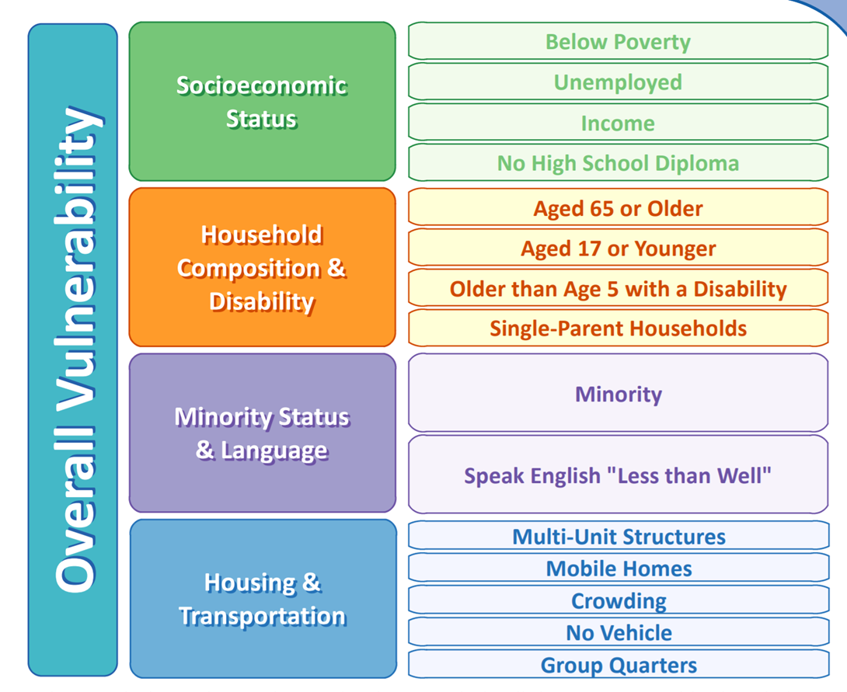
Social Vulnerability Index
Notes:
What is the SVI?
The Social Vulnerability Index uses U.S. Census data to determine the relative social vulnerability of every census tract. The SVI ranks each tract on 14 social factors and groups them into four related themes. Each tract receives a separate ranking for each of the four themes, as well as an overall ranking. The SVI can help emergency response planners and public health officials identify and map the communities that will most likely need support before, during, and after a hazardous event.

Slide 8
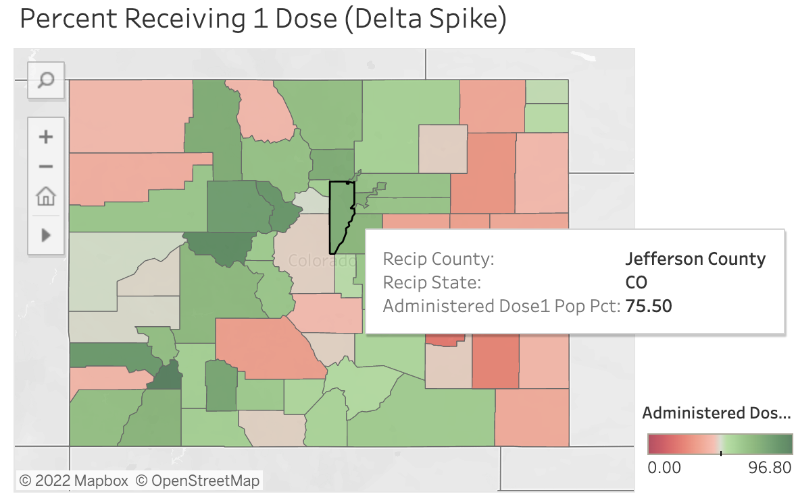
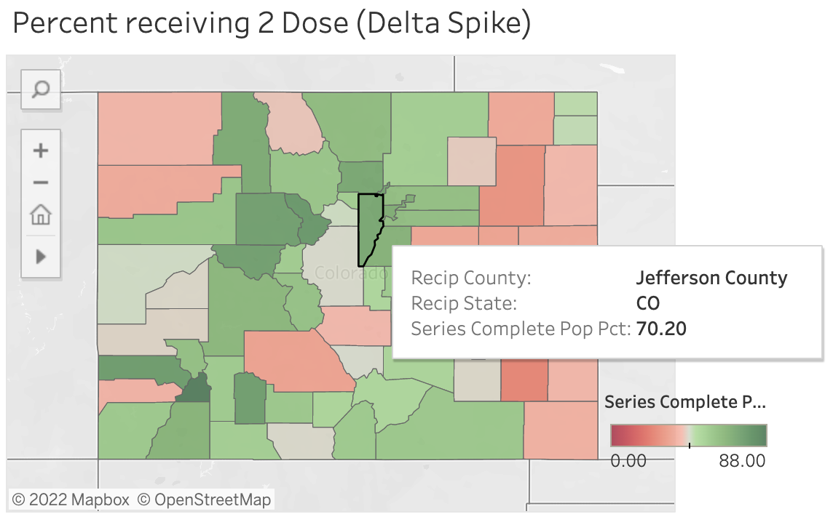
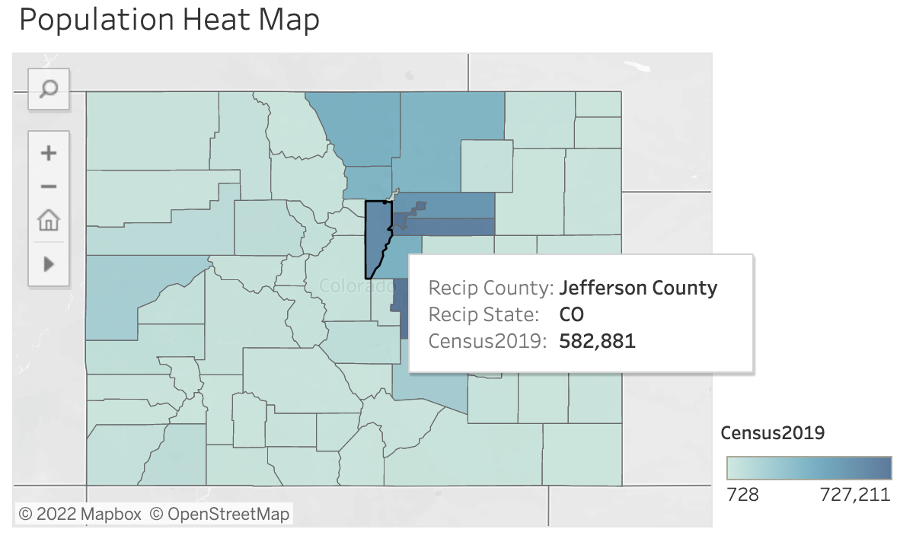
Data Exploration Using Tableau
Percentage of County Population with One-Dose
Percentage of County Population: Complete Series
Population by County
https://public.tableau.com/app/profile/jordan.brickman/viz/shared/H3Q25244H

Slide 9
Technology
Data was collected and preprocessed in Jupyter Notebook using Pandas with Python and SQL
Preprocessed data is connected and imported into Postgres using pgAdmin and AWS.
The database is then connected to the Machine Learning model that has been created using Python, Pandas, and Jupyter Notebook
The presentation will be displayed via Google Slides, as well as, an interactive webpage hosted via Tableau Public using HTML, CSS and Javascript.

Slide 10
Model Choice: Limitations and Benefits
We utilized both a Supervised Decision Tree and Random Forest Machine Learning Model.
Decision Tree Benefits: One of the most interpretable models, as they provide a clear representation of how the model works. Easy to classify or label objects
Decision Tree Drawbacks: Can become very complex and very deep, depending on how many questions have to be answered. Deep and complex trees tend to overfit to the data and do not generalize well.
Random Forest Benefits: Instead of having a single, complex tree like the ones created by decision trees, a random forest algorithm will sample the data and build several smaller, simpler decision trees. Random forest algorithms are beneficial because they are robust against overfitting as all of those weak learners are trained on different pieces of the data, are robust to outliers and nonlinear data and run efficiently on large datasets.
Random Forest Drawbacks: The main limitation of random forest is that a large number of trees can make the algorithm too slow and ineffective for real-time predictions. In general, these algorithms are fast to train, but quite slow to create predictions once they are trained.
Notes:
We used two different models for our ML Analysis. We first used the Decision Tree model because it is an easily interpretable. However, the Decision Tree can become complex and too deep easily, lending towards overfitting the data. For this reason, we also then ran a Random Forest Model as it can be robust against overfitting and works well for large datasets.

Slide 11
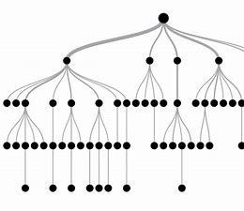

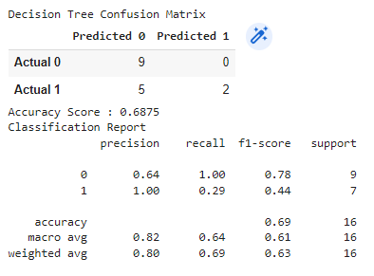
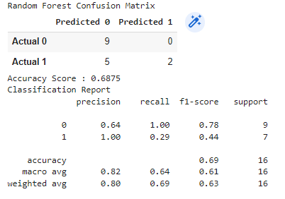
Results of the Machine Learning Model
Decision Tree Algorithm
Random Forest Algorithm
Notes:
Accuracy: Our models showed different levels of accuracy in our under sampling piece we received an accuracy of 78.5% and 81.25% in the Logistic Regression. This means that 78.5% and 81.25% in the testing set were predicted correctly by the model. Because we have a Supervised Machine Learning dataset with binary outcomes, the accuracy of the predictions can be further analyzed by viewing the Confusion Matrices for the two models.
In the Decision Tree Model, out of 14 Predicted True's, 5 were false positives and out of 2 Predicted Falses, there were 0 False Negatives. This model gave us an accuracy score of only 69%. We tried to keep our focus on the counties in Colorado but these low scores mean we should probably extend our model to include more data.
In the Random Forest Model, we received the same results.
Precision: For our models below, both the Decision Tree and Random Forest achieved a low Precision score of .64. Essentially meaning that out of 100 predicted positives, only 64 were True Positives.
Sensitivty/Recall: For our models below, both the Decision Tree and Random Forest achieved a Recall Score of 1.00. This means that the model is likely to correctly guess accurately if an outbreak will occur but again we can see that more data would make this amore robust model.
F1 Score: For our models below, both models achieved a F1 Score of .78.

Slide 12
Future Analysis
Applying the model to data sets in other states and/or countries
Applying the model to the peak of the Omicron Wave and future Waves

